Slide 1

Management Information Systems: Managing the Digital Firm
Seventeenth Edition, Global Edition
Chapter 14
Making the Business Case for Information Systems and Managing Projects
Copyright © 2022, 2020, 2018 Pearson Education, Ltd. All Rights Reserved
Notes:
If this PowerPoint presentation contains mathematical equations, you may need to check that your computer has the following installed:
1) MathType Plugin
2) Math Player (free versions available)
3) NVDA Reader (free versions available)

Slide 2
Learning Objectives
14.1 How should managers build a business case for the acquisition and development of new information systems?
14.2 What are the objectives of project management, and why is it so essential in developing information systems?
14.3 What are the principal risk factors in information systems projects?
14.4 How can project risk be managed?
14.5 How will M I S help my career?
Notes:
This chapter discusses the role and importance of developing a business case for the acquisition and development of a new information system and then effectively managing projects and project risk. Have students describe why project management is important to information systems projects. Have some students worked on projects (not necessarily IT projects) at work which were poorly managed? How many have worked on well-managed projects? What were the really significant factors that made for a “well-managed” (or “poorly managed”) project?

Slide 3
Video Cases
Case 1: NASA Project Management Challenges

Slide 4
Al-Asasyah Implements a Modern ERP Solution
Problem
  Diversified
  Many facilities and centers across Saudia Arabia
  Five main legacy systems
Solutions
  Careful selection of the ERP company
  Determining the scope, the plan, and cost estimate
  Evaluation and testing followed by transfer of data
Illustrates the influence of project management on implementing successful I T projects

Slide 5
Building a Business Case for the Acquisition and Development of a New Information System
Important elements of a business case
  Describes problem facing the organization
  Provides analysis of costs, benefits, and risks
  Describes rationale for proceeding with investment
  Shows how investment supports firm’s strategic goals
  Provides information necessary to make informed decision
  Explains how investment will provide value for business
  Identifies risks and alternative solutions
  Describes how solution may require changes in organizational culture, systems, processes, jobs
Notes:
This slide introduces the important elements that should be included in a business case for the acquisition and development of a new information system. One way to help students relate to this topic is to ask them to create a business case for a major purchase they have recently made, or would like to make, such as for a computer, smartphone, or car.

Slide 6
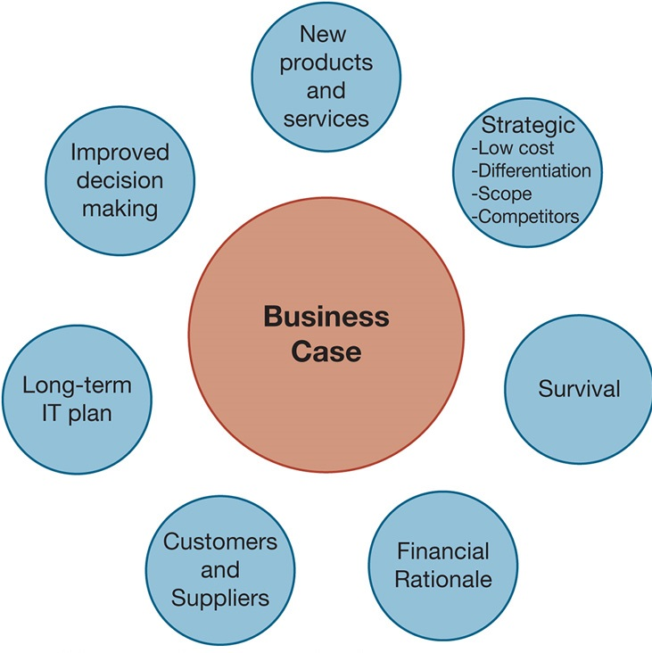
Figure 14.1 Factors to Consider in Making the Business Case
Notes:
Figure 14.1, Page 530.
There are seven factors that should be addressed when making the business case for an information system.
Alt Text
Long description: An illustration lists the seven factors to be considered when making the business case for an information system. The factors are listed as below:
New products and services
Strategic: Low cost; Differentiation; Scope; Competitors
Survival
Financial Rationale
Customers and Suppliers
Long term IT plan
Improved decision making.

Slide 7
Information Systems Plan (1 of 2)
Identifies systems projects that will deliver most business value
Links development to business plan
Road map indicating direction of systems development, includes:
  Purpose of plan
  Strategic business plan rationale
  Current systems/situation
  New developments
  Management strategy
  Implementation plan
  Budget
Notes:
This slide emphasizes the importance of making sure systems projects will support the firm’s overall business goals. A key document in ensuring this is the information systems plan. What management decisions are involved in the management strategy? (Hardware acquisition; telecommunications; centralization of authority, data, and hardware; required organizational change)

Slide 8
Information Systems Plan (2 of 2)
For effective plan
  Document existing systems and infrastructure components
  Identify decision-making improvements
  Develop metrics established for quantifying values
  Clear understanding of long-term and short-term information requirements
  Describe organizational changes required
Notes:
This slide continues the look at the steps a firm should take in selecting the right systems projects to pursue. Ask students why it is important to inventory existing hardware and software. Ask students to give an example of a long-term information requirement versus a short-term information requirement.

Slide 9
Portfolio Analysis
Used to evaluate alternative system projects
Inventories all of the organization’s information systems projects and assets
Each system has profile of risk and benefit
  High benefit, low risk
  High benefit, high risk
  Low benefit, low risk
  Low benefit, high risk
To improve return on portfolio, balance risk and return from systems investments
Notes:
This slide discusses portfolio analysis, a method used to evaluate alternative systems projects according to their levels of risk and benefit. In portfolio analysis, you seek to have a balance between types of systems, based on the level of risk you can afford, similar to a financial portfolio. Ask students what kinds of systems projects would be riskier than others. How could you determine the relative benefit of an information system?

Slide 10
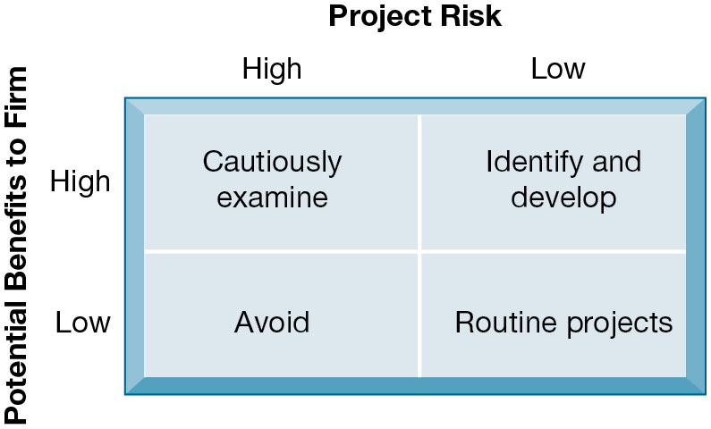
Figure 14.2 A System Portfolio
Notes:
Figure 14.2, Page 532.
Companies should examine their portfolio of projects in terms of potential benefits and likely risks. Certain kinds of projects should be avoided altogether and others developed rapidly. There is no ideal mix. Companies in different industries have different profiles.
This graphic illustrates the priorities a firm should give to information systems with different levels of risk and benefit. The only projects to avoid are high-risk, low-benefit projects. The emphasis given to any of the other three categories depends upon the individual firm. What types of influences on or within a firm might alter the firm’s emphasis on one category (e.g., high-benefit, high-risk) over another?
Alt Text
Long description: A two by two matrix explains the different levels of benefit and risk in a system portfolio. The vertical dimension of the matrix represents the potential benefits to the firm. The horizontal axis represents the project risk. The various possibilities are listed below:
Cautiously examine when potential benefits are high and project risk is also high.
Identify and develop when potential benefits are high and project risk is low.
Routine projects are those where potential benefits are low and project risk is also low.
Avoid when potential benefits are low and project risk is high.

Slide 11
Scoring Models
Used to evaluate alternative system projects, especially when many criteria exist
Assigns weights to various features of system and calculates weighted totals
Many qualitative judgments involved
Requires experts who understand the issues and the technology
Notes:
Scoring models are a convenient way to rank projects for development. But it is necessary to clarify precisely what are the dimensions of comparison and have all the participants in scoring systems to agree on how to measure these dimensions. A financial analysis should precede the use of scoring models so that everyone understands the financial impact on the firm using fairly objective criteria.

Slide 12
Table 14.2: Example of a Scoring Model for an E R P System
Criteria | Weight | E R P System A % | E R P System A Score | E R P System B % | E R P System B Score
1.1 Online order entry | 4 | 67 | 268 | 73 | 292
1.2 Online pricing | 4 | 81 | 324 | 87 | 348
1.3 Inventory check | 4 | 72 | 288 | 81 | 324
1.4 Customer credit check | 3 | 66 | 198 | 59 | 177
1.5 Invoicing | 4 | 73 | 292 | 82 | 328
2.1 Production forecasting | 3 | 72 | 216 | 76 | 228
2.2 Production planning | 4 | 79 | 316 | 81 | 324
(etc.) | (etc.) | (etc.) | (etc.) | (etc.) | (etc.)
Grand Totals |  |  | 3,128 |  | 3,300
Notes:
Table 14.2, Page 533.
This slide provides an excerpt from Table 14.2. For the full table, refer students to the text.

Slide 13
Determining Solution Costs and Benefits
Information system costs and benefits
  Tangible benefits
    Can be quantified and assigned monetary value
    Typically produced by systems that displace labor, save space
      E.g. transaction and clerical systems
  Intangible benefits
    Cannot be immediately quantified but may lead to quantifiable gains in the long run
      Example: more efficient customer service, enhanced decision making
    Typically produced by systems that influence decision making
      E.g. ESS, DSS, collaborative work systems
Notes:
In portfolio analysis, systems are compared along the lines of risk and benefit. This slide examines the ways a project’s benefits can be identified and quantified or evaluated. In addition to identifying direct costs (costs for hardware, services, personnel, etc.), firms need to identify tangible benefits and intangible benefits. Ask students to provide examples of tangible and intangible benefits. Note that Chapter 5 introduced the total cost of ownership (TCO) method for evaluating the cost of information systems projects. The TCO method does include expenditures beyond the initial cost of purchasing and installing hardware and software, but does not typically deal with benefits, cost categories such as complexity costs, or “soft” and strategic factors discussed later.

Slide 14
Capital Budgeting for Information Systems
Capital budgeting models
  Measure value of long-term capital investment projects
  Rely on measures of the firm’s cash outflows and inflows
Principal capital budgeting models used to evaluate I T projects
  Payback method
  Accounting rate of return on investment (R O I)
  Net present value
  Internal rate of return (I R R)
Limitations of financial models
Notes:
This slide introduces the practice of using financial analysis to determine what the return on investment is for an information systems project. Ask students why using these capital budgeting methods may be more accurate in understanding the value of an information system rather than a TCO approach. At the same time, what are some of the pitfalls of using only an ROI approach to investing in IT? Although costs might be relatively easy to establish, benefits are not so easy to identify, and especially in a quantitative manner.
Financial accounting methods do not take into account all of the factors that can affect costs and benefits. Ask the students to describe some of the factors that may affect revenues or costs (costs from organizational disruptions: cost to train end users, productivity costs due to users’ learning curves for a new system, time managers need to spend overseeing new system-related changes) as well as some of the benefits that may not be addressed by financial methods (more timely decisions from a new system, enhanced employee learning and expertise).

Slide 15
Runaway Projects and System Failure
Runaway projects
  Exceed budget, schedule
    McKinsey/Oxford University study: ran 66 percent over budget; 33 percent over schedule
Types of system failure
  Fail to capture essential business requirements
  Fail to provide organizational benefits
  Complicated, poorly organized user interface
  Inaccurate or inconsistent data
Notes:
This slide emphasizes the high risk that projects may run over budget or take more time than anticipated to deliver. Ask students why they think this occurs so frequently. The slide also details the main ways a system can be considered to have “failed.” Ask students what is meant by “Fail to provide organizational benefits” and provide an example.

Slide 16
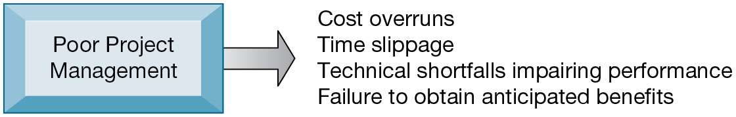
Figure 14.4 Consequences of Poor Project Management
Notes:
Figure 14.4, Page 537.
Without proper management, a systems development project takes longer to complete and most often exceeds the allocated budget. The resulting information system most likely is technically inferior and may not be able to demonstrate any benefits to the organization.
This graphic illustrates the main consequences when an information project is not properly managed. Have any students encountered an information system that was too difficult to use or that didn’t work as intended? Have any students experienced a poorly managed project?

Slide 17
Project Management Objectives
Project: planned series of related activities for achieving a specified business objective
Project management
  Activities include planning work, assessing risk, estimating resources required, organizing the work, assigning tasks, controlling project execution, reporting progress, analyzing results
Five major variables
  Scope
  Time
  Cost
  Quality
  Risk
Notes:
This slide introduces the main activities involved in project management and lists the five major variables that project management must deal with. Ask students to describe what “scope” means. You can also ask students what project management activities concern the five variables. For example, to control scope, project managers define the work as included in the project. To manage the time spent on the project, project management estimates the time to complete each task and schedules the tasks for optimal efficiency.

Slide 18
Dimensions of Project Risk
Project size
  Cost
  Time
  Number of organizational units affected
  Organizational complexity
Project structure
  Structured, defined requirements run lower risk
Experience with technology
  Team familiar with hardware and software
Notes:
This slide discusses a major factor in evaluating projects, risk. (Remember that portfolio analysis ranks systems according to two criteria, benefit and risk.) Most managers don’t like to think about risk and most make no attempt to measure it. Most managers are optimists and think about benefits. For instance, in the financial meltdown of 2007, financial managers did not seriously consider risk, or worse, neglected risk calculations. A great many systems projects fail, which perhaps could have been avoided had managers had a better understanding of project risk.
What is meant by risk? Ask students how the size of a project affects its risk. What does organizational complexity mean in this context? Which of these components are organizational versus technical? Can all of them be countered through better project management?

Slide 19
Change Management and the Concept of Implementation (1 of 3)
Change management
  Required for successful system building
  New information systems have powerful behavioral and organizational impact
Implementation
  All organizational activities working toward adoption, management, and routinization of an innovation
Change agent
  One role of systems analyst
  Redefines the configurations, interactions, job activities, and power relationships of organizational groups
Notes:
This slide emphasizes that introduction or alteration of an information system has a powerful behavioral and organizational impact. Change management is required to counter resistance and opposition. Ask students for examples of behavioral and organizational impacts that a new information system might have. What types of changes should an analyst look for in assessing the impact of a new system?
This slide also introduces the concept of implementation and the role of the systems analyst as a change agent, a key role in change management efforts. Ask students what types of activities a change agent would engage in to encourage the adoption of a new information system throughout the enterprise. Why don’t employees and managers simply adopt new systems without question?

Slide 20
Change Management and the Concept of Implementation (2 of 3)
Role of end users
  With high levels of user involvement
    System more likely to conform to requirements
    Users more likely to accept system
User–designer communication gap
  Users and information systems specialists
Management support and commitment
  Affects positive perception by both users and technical staff
  Ensures sufficient funding and resources
  Helps enforce required organizational changes
Notes:
Two important factors in successful implementation are user involvement and management support. This slide discusses the role of users and the effects of the user–designer communications gap. Ask students to provide examples of user concerns and designer concerns regarding an information system. What are the goals of these two groups?
This slide also discusses a second major factor in successful implementation—management support. It is particularly important to note that if management gives high priority to a project then the project will more likely be treated the same way by users. In what ways can management show support for a project? Which of these are most likely to influence users and technical staff? Why would managers sometimes not show enthusiastic support for a project? (Sometimes, personal, political, and organizational culture differences reduce support for some projects.)

Slide 21
Change Management and the Concept of Implementation (3 of 3)
Change management challenges for business process management (BPM), enterprise applications, and mergers and acquisitions
  Very high failure rate among enterprise application and B P M projects (up to 70 percent for far-reaching BPM)
    Poor implementation and change management practices
      Employee concerns about change
      Resistance by key managers
      Changing job functions, career paths, recruitment practices
  Mergers and acquisitions
    Similarly high failure rate of integration projects
    Merging of systems of two companies requires:
      Considerable organizational change, complex systems projects
Notes:
This slide emphasizes the high failure rate for large-scale enterprise and business process management (BPM) projects and the importance of implementation and change management. To some extent, the failure rate has declined in recent years as the major vendor firms stabilized their offerings, making the technology less of a risk. In turn, large corporations have developed a deep experience base with large scale systems. Nevertheless, large-scale system implementations almost invariably run over budget, and are behind schedule.
Ask students to recall what implementation means. Ask students why both employees and managers become concerned about changes to functions and career paths.

Slide 22
Managing Project Risks
First step involves identifying nature and level of risk of project
Each project can then be managed with tools and risk-management approaches geared to level of risk
Managing technical complexity
  Internal integration tools
    Project leaders with technical and administrative experience
    Highly experienced team members
    Frequent team meetings
    Securing of technical experience outside firm if necessary
Notes:
The next few slides discuss various project management, requirements gathering, and planning methodologies that can be used to counter different types of implementation problems. For instance, technical complexity can be managed by using internal integration tools. Why are these called “internal integration” tools?

Slide 23
Formal Planning and Control Tools
Used for documenting and monitoring project plans
Help identify bottlenecks and impact of problems
Gantt charts
  Visual representation of timing and duration of tasks
  Human resource requirements of tasks
P E R T charts
  Graphically depict tasks and interrelationships
  Indicate sequence of tasks necessary

Slide 24
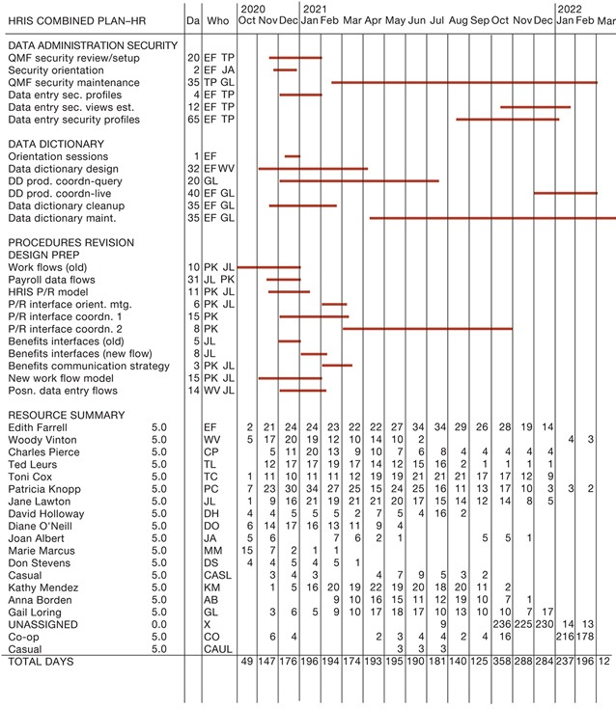
Figure 14.5 A Gantt Chart
Notes:
Figure 14.5, Page 543.
The Gantt chart in this figure shows the task, person-days, and initials of each responsible person as well as the start and finish dates for each task. The resource summary provides a good manager with the total person-days for each month and for each person working on the project to manage the project successfully. The project described here is a data administration project.
This slide shows a Gantt Chart. The orange lines show the beginning, duration, and end of each task. Organizing a project in this way can allow a manager to see what is or should be worked on at any given time.
Alt Text
Long description: A sample Gantt Chart with a resource summary for a data administration project. The Gantt chart here is similar to that of a horizontal bar chart and illustrates a project schedule. This chart lists the tasks to be performed on the vertical axis, and time intervals on the horizontal axis.
The width of the horizontal bars in the graph shows the duration of each activity, by illustrating the start and finish dates of a project.
The details of the task, person-days, and initials of each responsible person as well as the start and finish dates for each task are described below:
Data administration security:
QMF security review or setup: Days, 20; Who, EF and TP; Timeline, Mid November 2020 to End of January 2021.
Security orientation: Days, 2; Who, EF and JA; Timeline, last week of November 2020 to 3rd week of December 2020.
QMF security maintenance: Days, 35; Who, TP and GL; Timeline, Mid-February 2021 to end of February 2022.
Data entry sec. profiles: Days, 4; Who, EF and TP; Timeline, December 2020 to January 2021.
Data entry sec. views estimation: Days, 12; Who, EF and TP; Timeline, Mid-October 2021 to 3rd week of January 2022.
Data entry security profiles: Days, 65; Who, EF and TP; Timeline, Mid-August 2021 to 1st week of January 2022.
Data dictionary:
Orientation sessions: Days, 1; Who, EF; Timeline, 2nd to 4th week of December 2020.
Data dictionary design: Days, 30; Who, EF and WV; Timeline, October 2020 to 1st week of April 2021.
DD production and coordination-query: Days, 20; Who, GL; Timeline, December 2020 to Mid-June 2021.
DD production and coordination-live: Days, 40; Who, EF and GL; Timeline, December 2021 to February 2022.
Data dictionary cleanup: Days, 35; Who, EF and GL; Timeline, October 2020 to 3rd week of February 2021.
Data dictionary maintenance: Days, 35; Who, EF and GL; Timeline, 2nd week of April 2021 to March 2022.
Procedures revision and design preparation:
Work flows (old): Days, 10; Who, PK and JL; Timeline, October to December 2020.
Payroll data flows: Days, 31; Who, JL and PK; Timeline, October to December 2020.
HRIS P/R model: Days, 11; Who, PK and JL; Timeline, Mid-November 2020 to Mid-January 2021.
P/R interface orientation meeting: Days, 6; Who, PK and JL; Timeline, February to First week of March 2021.
P/R interface coordination 1: Days, 15; Who, PK; Timeline, December 2020 to First week of March 2021.
P/R interface coordination 2: Days, 8; Who, PK; Timeline, March to November 2021.
Benefits interfaces (old): Days, 5; Who, JL; Timeline, December 2020.
Benefits interfaces (new flow): Days, 8; Who, JL; Timeline, January to Mid-February 2021.
Benefits communication strategy: Days, 3; Who, PK and JL; Timeline, February to Mid-March 2021.
New work flow model: Days, 15; Who, PK and JL; Timeline, November 2020 to 1st Week of January 2021.
Position data entry flows: Days, 14; Who, WV and JL; Timeline, 2nd week of December 2020 to 2nd week of January 2021.
The resource summary details are as below:
Edith Farrell (EF): Oct’20, 2; Nov’20, 21; Dec’20: 24; Jan’21:24; Feb’21: 23; Mar’21: 22; Apr’21: 22; May’21: 27; Jun’21: 34; July’21: 34; Aug’21: 29; Sep’21: 26; Oct’21, 28; Nov’21, 19; Dec’21,14; Jan’22, NA; Feb’22, NA; Mar’22, NA.
Woody Vinton(WV): Oct’20, 5; Nov’20, 17; Dec’20: 20; Jan’21:19; Feb’21: 12; Mar’21: 10; Apr’21: 14; May’21: 2; Jun’21: NA; July’21: NA; Aug’21: NA; Sep’21: NA; Oct’21, NA Nov’21, NA; Dec’21, NA; Jan’22, 4; Feb’22, 3; Mar’22, NA.
Charles Pierce (CP): Oct’20, NA; Nov’20, 5; Dec’20: 11; Jan’21:20; Feb’21: 13; Mar’21: 9; Apr’21: 10; May’21: 7; Jun’21: 6; July’21: 8; Aug’21: 4; Sep’21: 4; Oct’21, 4; Nov’21, 4; Dec’21,4; Jan’22, NA; Feb’22, NA; Mar’22, NA.
Ted Leurs (TL): Oct’20, NA; Nov’20, 12; Dec’20: 17; Jan’21:17; Feb’21: 19; Mar’21: 17; Apr’21: 14; May’21: 12; Jun’21: 15; July’21: 16; Aug’21: 2; Sep’21: 1; Oct’21, 1; Nov’21, 1; Dec’21,1; Jan’22, NA; Feb’22, NA; Mar’22, NA.
Toni Cox (TC): Oct’20, 1; Nov’20, 11; Dec’20: 10; Jan’21:11; Feb’21: 11; Mar’21: 12; Apr’21: 19; May’21: 19; Jun’21: 21; July’21: 21; Aug’21: 21; Sep’21: 17; Oct’21, 17; Nov’21, 12; Dec’21,19; Jan’22, NA; Feb’22, NA; Mar’22, NA.
Patricia Knopp (PK): Oct’20, 7; Nov’20, 23; Dec’20: 30; Jan’21:34; Feb’21: 27; Mar’21: 25; Apr’21: 15; May’21: 24; Jun’21: 25; July’21: 16; Aug’21: 11; Sep’21: 13; Oct’21, 17; Nov’21, 10; Dec’21,3; Jan’22, 3; Feb’22, 2; Mar’22, NA.
Jane Lawton(JL): Oct’20, 1; Nov’20, 9; Dec’20: 16; Jan’21:21; Feb’21: 19; Mar’21: 21; Apr’21: 21; May’21: 20; Jun’21: 17; July’21: 15; Aug’21: 14; Sep’21: 12; Oct’21, 14; Nov’21, 8; Dec’21,5; Jan’22, NA; Feb’22, NA; Mar’22, NA.
David Holloway(DH): Oct’20, 4; Nov’20, 4; Dec’20: 5; Jan’21: 5; Feb’21: 5; Mar’21: 2; Apr’21: 7; May’21: 5; Jun’21: 4; July’21: 16; Aug’21: 2; Sep’21: NA; Oct’21, NA; Nov’21, NA; Dec’21, NA; Jan’22, NA; Feb’22, NA; Mar’22, NA.
Diane O'Neill(DN): Oct’20, 6; Nov’20, 14; Dec’20: 17; Jan’21:16; Feb’21: 13; Mar’21: 11; Apr’21: 9; May’21: 4; Jun’21: NA; July’21: NA; Aug’21: NA; Sep’21: NA; Oct’21, NA; Nov’21, NA; Dec’21, NA; Jan’22, NA; Feb’22, NA; Mar’22, NA.
Joan Albert(JA): Oct’20, 5; Nov’20, 6; Dec’20: NA; Jan’21:NA; Feb’21: 7; Mar’21: 6; Apr’21: 2; May’21: 1; Jun’21: NA; July’21: NA; Aug’21: NA; Sep’21: 5; Oct’21, 5; Nov’21, 1; Dec’21, NA; Jan’22, NA; Feb’22, NA; Mar’22, NA.
Marie Marcus(MM): Oct’20, 15; Nov’20, 7; Dec’20: 2; Jan’21:1; Feb’21: 1; Mar’21: NA; Apr’21: NA; May’21: NA; Jun’21: NA; July’21: NA; Aug’21: NA; Sep’21: NA; Oct’21, NA; Nov’21, NA; Dec’21, NA; Jan’22, NA; Feb’22, NA; Mar’22, NA.
Don Stevens(DS): Oct’20, 4; Nov’20, 4; Dec’20: 4; Jan’21:4; Feb’21: 5; Mar’21: 1; Apr’21: NA; May’21: NA; Jun’21: NA; July’21: NA; Aug’21: NA; Sep’21: NA; Oct’21, NA; Nov’21, NA; Dec’21, NA; Jan’22, NA; Feb’22, NA; Mar’22, NA.
Casual(CASL): Oct’20, NA; Nov’20, 3; Dec’20: 4; Jan’21:3; Feb’21: NA; Mar’21: NA; Apr’21: 4; May’21: 7; Jun’21: 9; July’21: 5; Aug’21: 3; Sep’21: 2; Oct’21, NA; Nov’21, NA; Dec’21, NA; Jan’22, NA; Feb’22, NA; Mar’22, NA.
Kathy Mendez(KM): Oct’20, NA; Nov’20, 1; Dec’20: 5; Jan’21:16; Feb’21: 20; Mar’21: 19; Apr’21: 22; May’21: 19; Jun’21: 20; July’21: 18; Aug’21: 20; Sep’21: 11; Oct’21, 2; Nov’21, NA; Dec’21, NA; Jan’22, NA; Feb’22, NA; Mar’22, NA.
Anna Borden(AB): Oct’20, NA; Nov’20, NA; Dec’20: NA; Jan’21:NA; Feb’21: 9; Mar’21: 10; Apr’21: 16; May’21: 15; Jun’21: 11; July’21: 12; Aug’21: 19; Sep’21: 10; Oct’21, 7; Nov’21, 1; Dec’21, NA; Jan’22, NA; Feb’22, NA; Mar’22, NA.
Gail Loring(GL): Oct’20, NA; Nov’20, 3; Dec’20: 6; Jan’21:5; Feb’21: 9; Mar’21: 10; Apr’21: 17; May’21: 18; Jun’21: 17; July’21: 10; Aug’21: 13; Sep’21: 10; Oct’21, 10; Nov’21, 7; Dec’21,17; Jan’22, NA; Feb’22, NA; Mar’22, NA.
UNASSIGNED(X): Oct’20, NA; Nov’20, NA; Dec’20: NA; Jan’21:NA; Feb’21: NA; Mar’21: NA; Apr’21: NA; May’21: NA; Jun’21: NA; July’21: 9; Aug’21: NA; Sep’21: NA; Oct’21, 236; Nov’21, 225; Dec’21,230; Jan’22, 14; Feb’22, 13; Mar’22, NA.
Co-op(CO): Oct’20, NA; Nov’20, 6; Dec’20: 4; Jan’21:NA; Feb’21: NA; Mar’21: NA; Apr’21: 2; May’21: 3; Jun’21: 4; July’21: 4; Aug’21: 2; Sep’21: 4; Oct’21, 16; Nov’21, NA; Dec’21, NA; Jan’22, 216; Feb’22, 178; Mar’22, NA.
Casual(CAUL): Oct’20, NA; Nov’20, NA; Dec’20: NA; Jan’21:NA; Feb’21: NA; Mar’21: NA; Apr’21: NA; May’21: 3; Jun’21: 3; July’21: 3; Aug’21: NA; Sep’21: NA; Oct’21, NA; Nov’21, NA; Dec’21, NA Jan’22, NA; Feb’22, NA; Mar’22, NA.
Total days: Oct’20, 49; Nov’20,147; Dec’20: 176; Jan’21:196; Feb’21: 194; Mar’21: 174; Apr’21: 193; May’21: 195; Jun’21: 190; July’21: 181; Aug’21: 140; Sep’21: 125; Oct’21, 358; Nov’21, 288; Dec’21, 284 Jan’22, 237; Feb’22, 196; Mar’22, 12.
All resource names have 5.0 mentioned in front of them, except unassigned resource which has 0.0 in front of it.

Slide 25
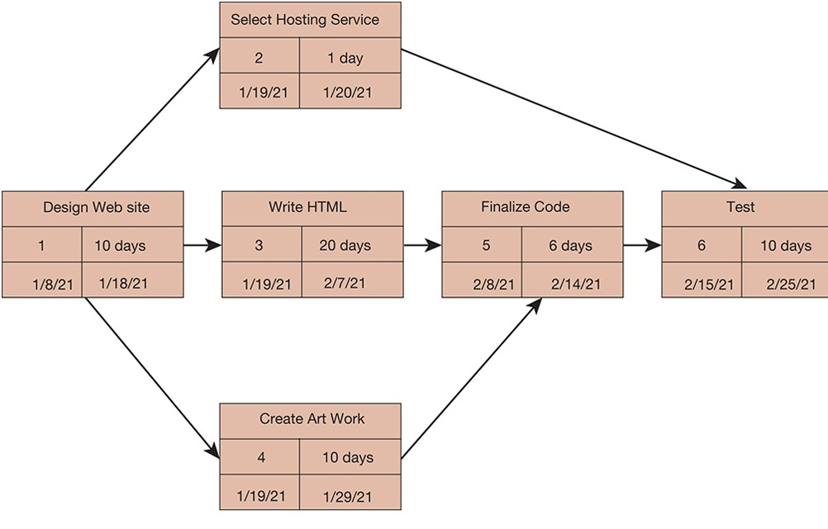
Figure 14.6 A PERT Chart
Notes:
Figure 14.6, Page 544.
This is a simplified PERT chart for creating a small website. It shows the ordering of project tasks and the relationship of a task with preceding and succeeding tasks.
This graphic is a simplified PERT chart, which shows the dependencies between project tasks. Ask students to define what “dependencies” means and to point out the dependencies in this chart. Why are dependencies important to consider when managing a project?
Alt Text
Full description: A graphical representation illustrates a sample project’s timeline for creating a website. Tasks of the project are numbered from 1 to 6, labelled as follows, with date-wise timeline in terms of number of days:
1: Design web site; 10 days from 8th January, 2021 to 18th January, 2021.
2: Select hosting service; 1 day from 19th January, 2021 to 20th January, 2021.
3: Write HTML; 20 days from 19th January, 2021 to 7th February, 2021.
4: Create art work; 10 days from 19th January, 2021 to 29th January, 2021.
5: Finalize code; 6 days from 8th February, 2021 to 14th February, 2021.
6: Test; 10 days from 15th February, 2021 to 25th February, 2021.
Flow of three orders of the above mentioned tasks are displayed with unidirectional arrows as follows:
Design web site, select hosting service, and test.
Design web site, write HTML, finalize code, and test.
Design web site, create art work, finalize code, and test.

Slide 26
Increasing User Involvement and Overcoming User Resistance
External integration tools
  Link work of implementation team to users at all levels
User resistance to organizational change
  Counterimplementation
Strategies to overcome user resistance
  User participation, education and training
  Management edicts and policies
  Incentives for cooperation
  Improvement of end-user interface
  Resolution of organizational problems prior to introduction of new system
Notes:
This slide discusses a third type of tool to meet implementation challenges—external integration tools—and discusses the forms that user resistance may take. Ask students if they have ever witnessed user resistance to an information system at their workplaces.
This slide also discusses methods to counter user resistance. Ask students why simply declaring a system “mandatory” may not be the best approach to effect user participation.

Slide 27
Designing for the Organization
Need to address ways in which organization changes with new system
Ergonomics
  Interaction of people and machines in work environment
Organizational impact analysis
  How system will affect organizational structure, attitudes, decision making, operations
Sociotechnical design
  Addresses human and organizational issues
Notes:
This slide discusses the ways in which a new information system can impact an organization. Table 14.5 in the text lists the organizational factors in systems planning and implementation. Ask students to identify some of these. (Employee participation and involvement, job design, standards and performance monitoring, ergonomics, employee grievance resolution procedures, health and safety, government regulatory compliance.)
This slide also discusses the use of an organizational impact analysis to anticipate how an upcoming system will affect an organization. It further discusses the use of sociotechnical design, a method to address human and organizational practices into information systems projects.

Slide 28
Interactive Session: Management: Sauder Woodworking Gets ERP Implementation Right
Class discussion
  Why is an ERP system so important for Sauder Woodworking. Why did Sauder want to switch to a newer ERP system?
  Was SAP S/4HANA a good choice for Sauder? Why or why not?
  Were there any risks in this project. How did Sauder deal with them?

Slide 29
Project Management Software Tools
Can automate many aspects of project management
Capabilities for defining, ordering tasks
  Assigning resources to tasks, tracking progress
  Manage very large numbers of tasks and relationships
Microsoft Project
Cloud-based software
Project portfolio management software
Notes:
This slide discusses commercial software that is available to assist in managing projects, the most popular of which is Microsoft Project. There are also numerous cloud-based project management tools. Ask students if they have ever used any project management software.

Slide 30
Interactive Session: Technology: Arup Moves Project Management to the Cloud
Class discussion
  What is the relationship between information technology, project management, and Arup’s business model and business strategy?
  How does Microsoft Project Online support Arup’s business strategy? How did it change the way the company works?
  What management, organization, and technology issues did Arup have to address when selecting Project Online as its global project portfolio management tool?

Slide 31
How Will M I S Help My Career?
The Company: XYZ Multimedia Entertainment
Position Description: Entry-level I T project management assistant
Job Requirements
Interview Questions
Author Tips
Notes:
A good opportunity for a class discussion of the section on careers. Would any in the class be interested in a job like this? What do they think are the most important skills the employer is looking for? How would they answer the interviewer questions?

Slide 32

Copyright
This work is protected by United States copyright laws and is provided solely for the use of instructors in teaching their courses and assessing student learning. Dissemination or sale of any part of this work (including on the World Wide Web) will destroy the integrity of the work and is not permitted. The work and materials from it should never be made available to students except by instructors using the accompanying text in their classes. All recipients of this work are expected to abide by these restrictions and to honor the intended pedagogical purposes and the needs of other instructors who rely on these materials.

